Slide 1


Slide 2
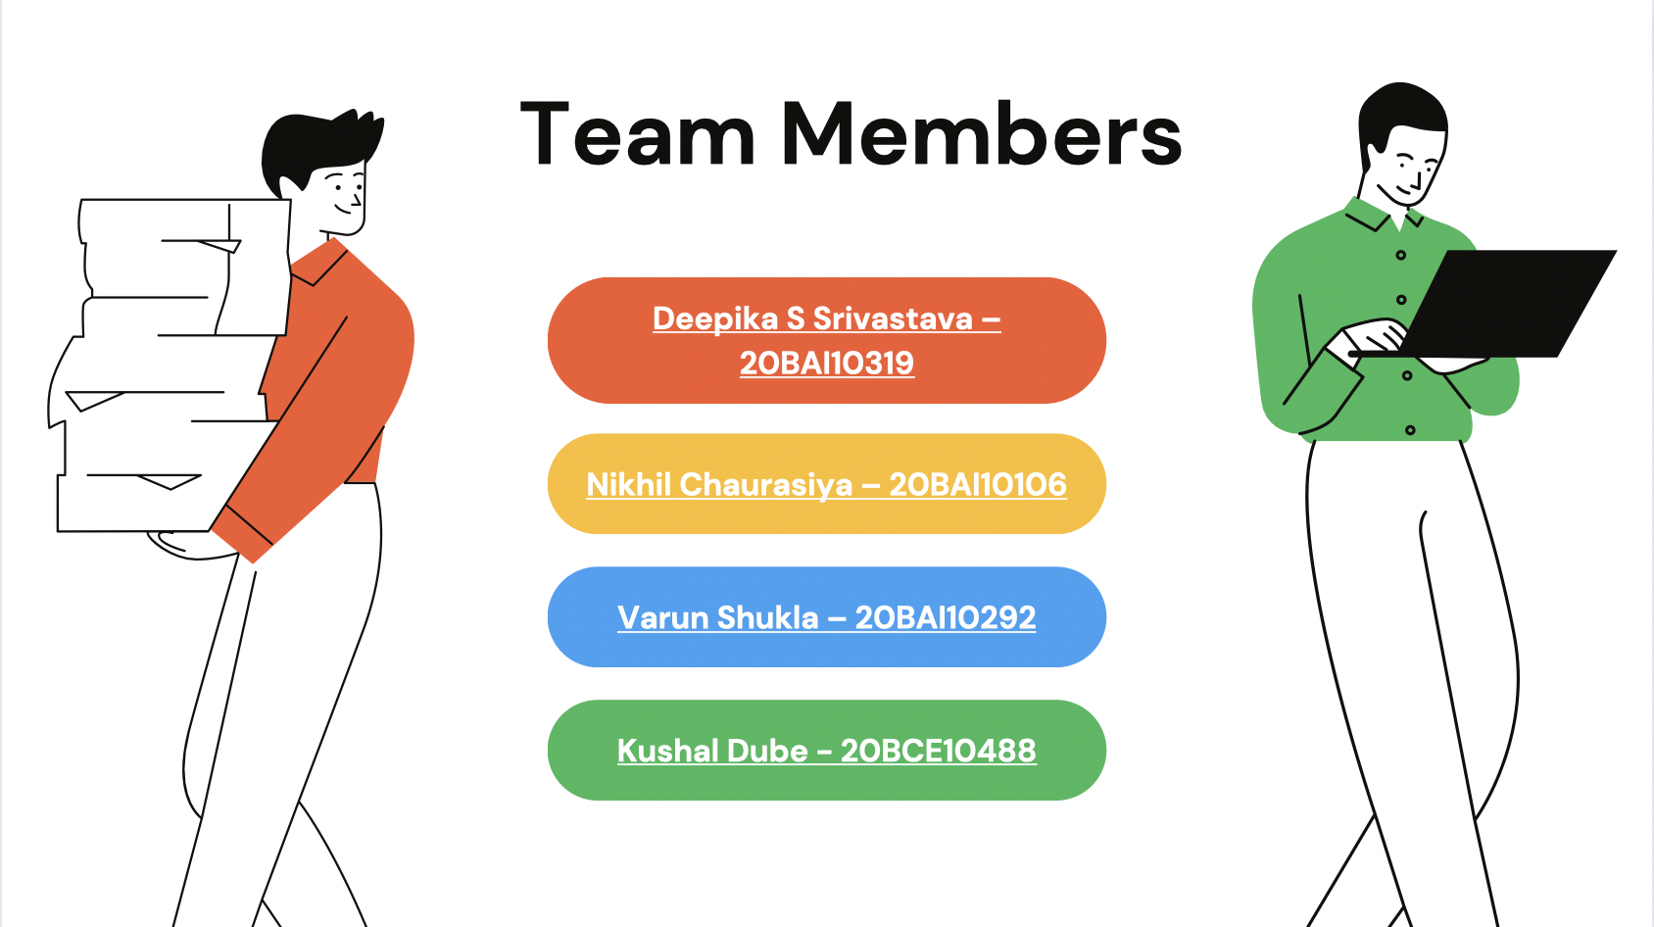

Slide 3
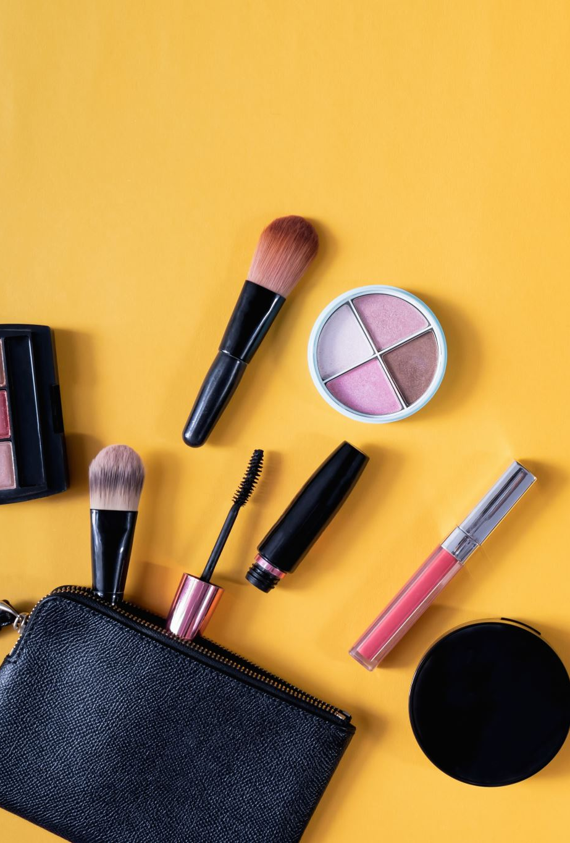
Problem Statement
Connected experiences for consumers: How do you ensure that consumers are loyal to brands and will not switch between brands?
Brenda is a retail store assistant, working for a large cosmetics retailer. She has been noticing that many of her loyal customers who would buy a certain shade of lipstick or eye shadow have been switching to a rival brand which makes similar shades at a lower price. However, she realizes that her brand has much better-quality products, and would like to provide attractive offers to her customers to retain them. She would like to have solutions for:
Digitizing the buying cycle of the consumer through D2C (Direct-to-Consumer)
Hyper-personalizing consumer experience using insights into individual preferences
Digital marketing campaigns and loyalty programs

Slide 4
Background Research and Work
A Deep Learning Perspective on Beauty, Sentiment, and Remembrance of Art
Impact and Detection of Facial Beautification in Face Recognition: An Overview
Deep learning method for makeup style transfer: A survey
Our Work:
Video representation of our web app
Background Research: Simplifying the features to be added

Slide 5
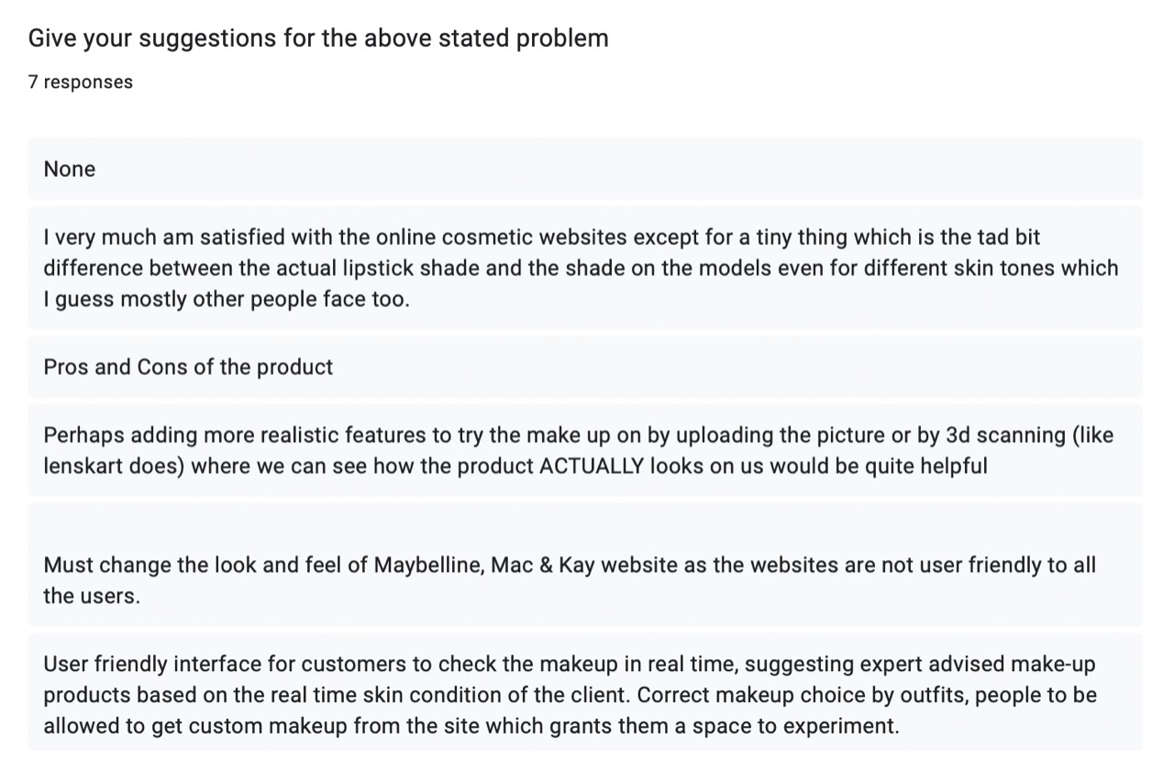
Taking people’s review

Slide 6
Existing work
Myntra - Uses AR to give outfit suggestions.
Snapchat and Instagram - Uses face filters which have beauty products like lipsticks.
Maybelline - Uses AR to try its products using live camera but it is very much inefficient.
Nykaa - Has a Beauty book which gives information about the products and also expert talks.
Kiosk model is still in the ideation stage in the States past 2 years

Slide 7

Proposed Idea

Slide 8
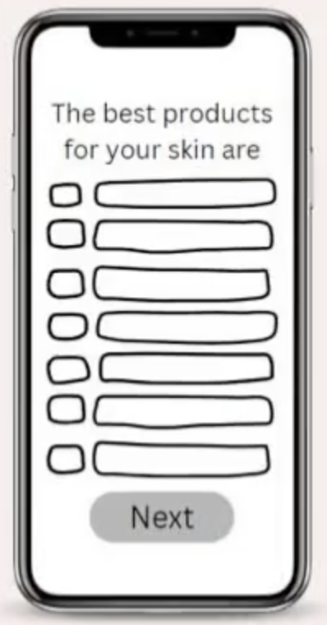
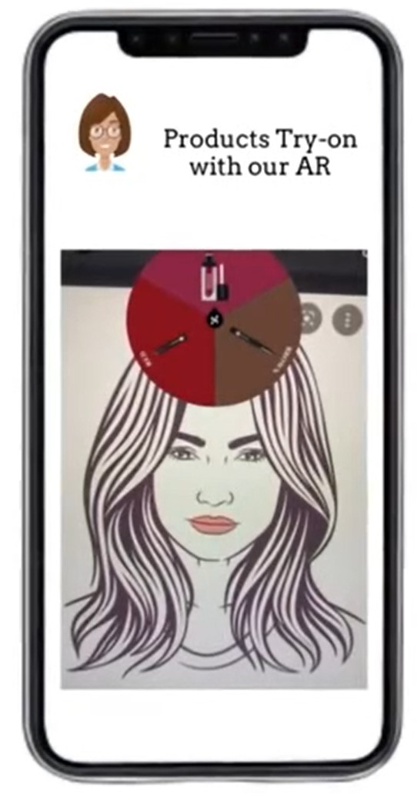
Digitizing the buying cycle of the consumer through D2C (Direct-to-Consumer).
Making the web app and integrating the features including the technology application development , cloud computing , artificial intelligence and augmented reality (AR).
A recommender system which will recommend products according to the skin type.
Digitizing the buying cycle of the consumer through D2C (Direct-to-Consumer).
Making the web app and integrating the features including the technology application development , cloud computing , artificial intelligence and augmented reality (AR).
A recommender system which will recommend products according to the skin type.

Slide 9
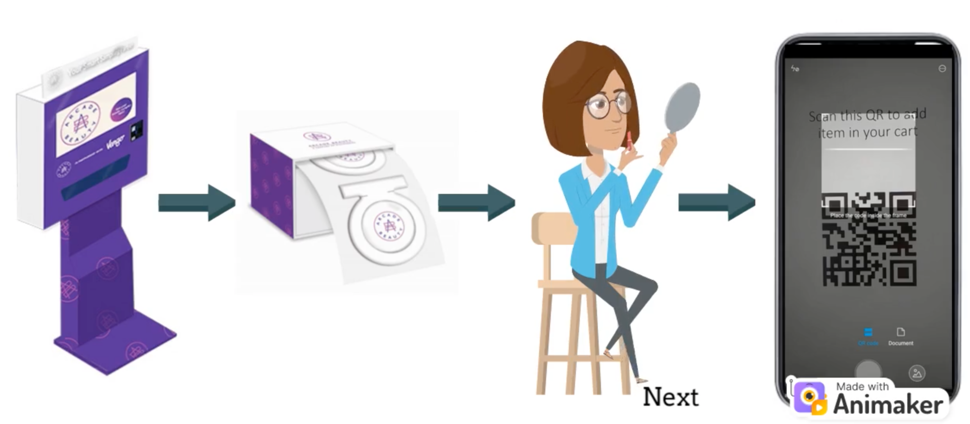
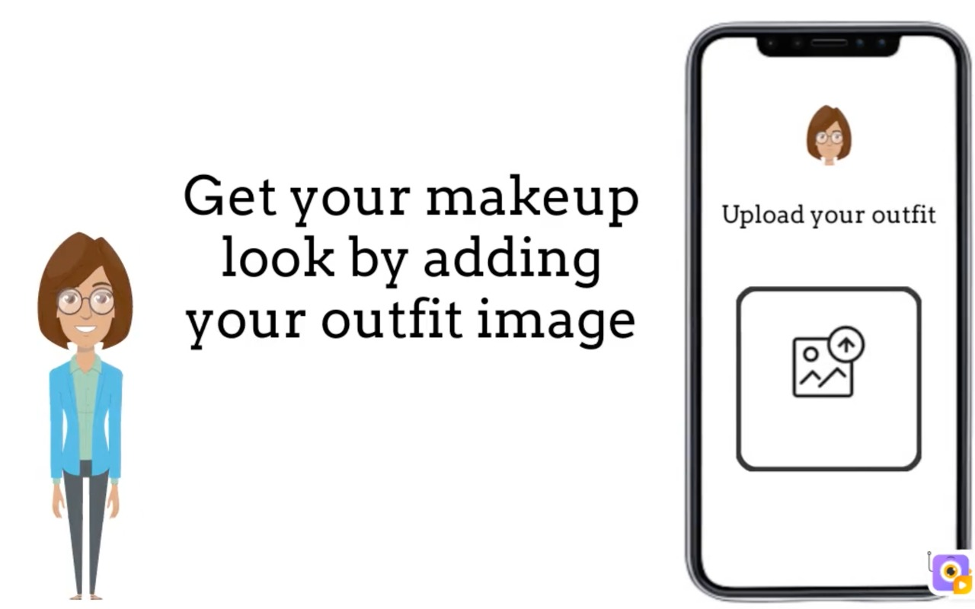
Hyper-personalizing consumer experience using insights into individual preferences:
As cosmetics industry is mainly unorganised and people see each ingredient what is being used and they are being very specific with the product they are buying making it very choosy industry to bet on. We come up with the solution of KIOSK, where they can get try on sachets of small amount, with minimal cost.
Through AI, personalised recommendation of the products based on the details of skin type entered by the user. Also recommend what cosmetics suits you up in the outfit the user is wearing through our AI integrated with AR.
AR to let them choose the correct shade with no colour difference.

Slide 10
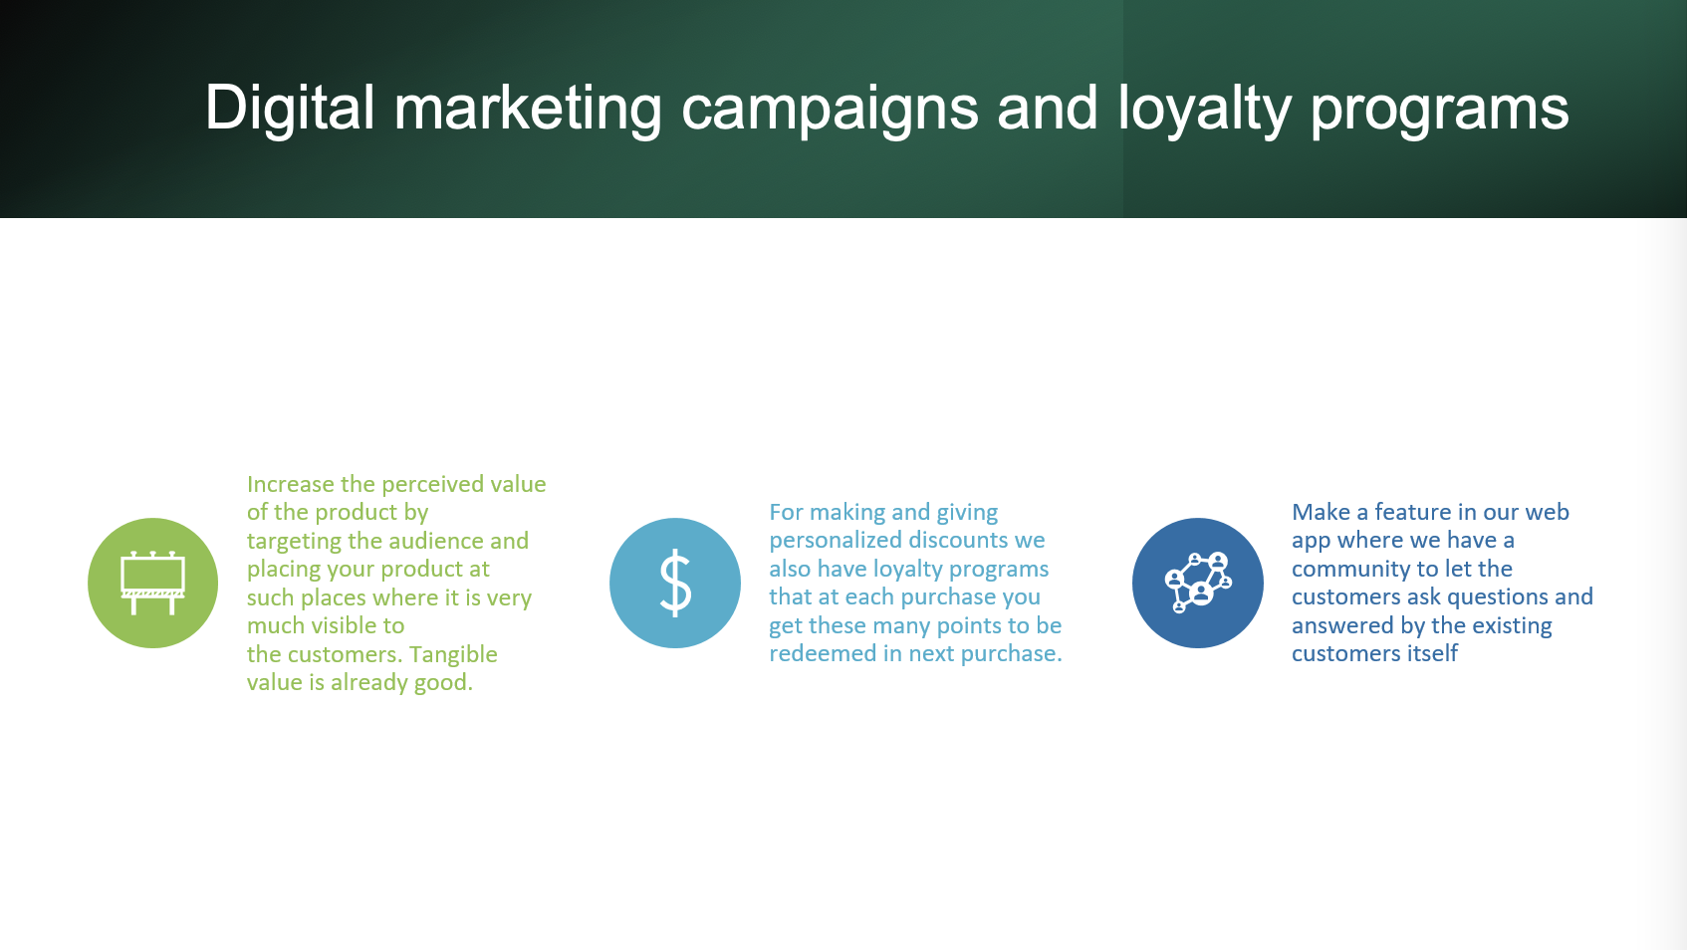

Slide 11

Some Features of the web app

Slide 12
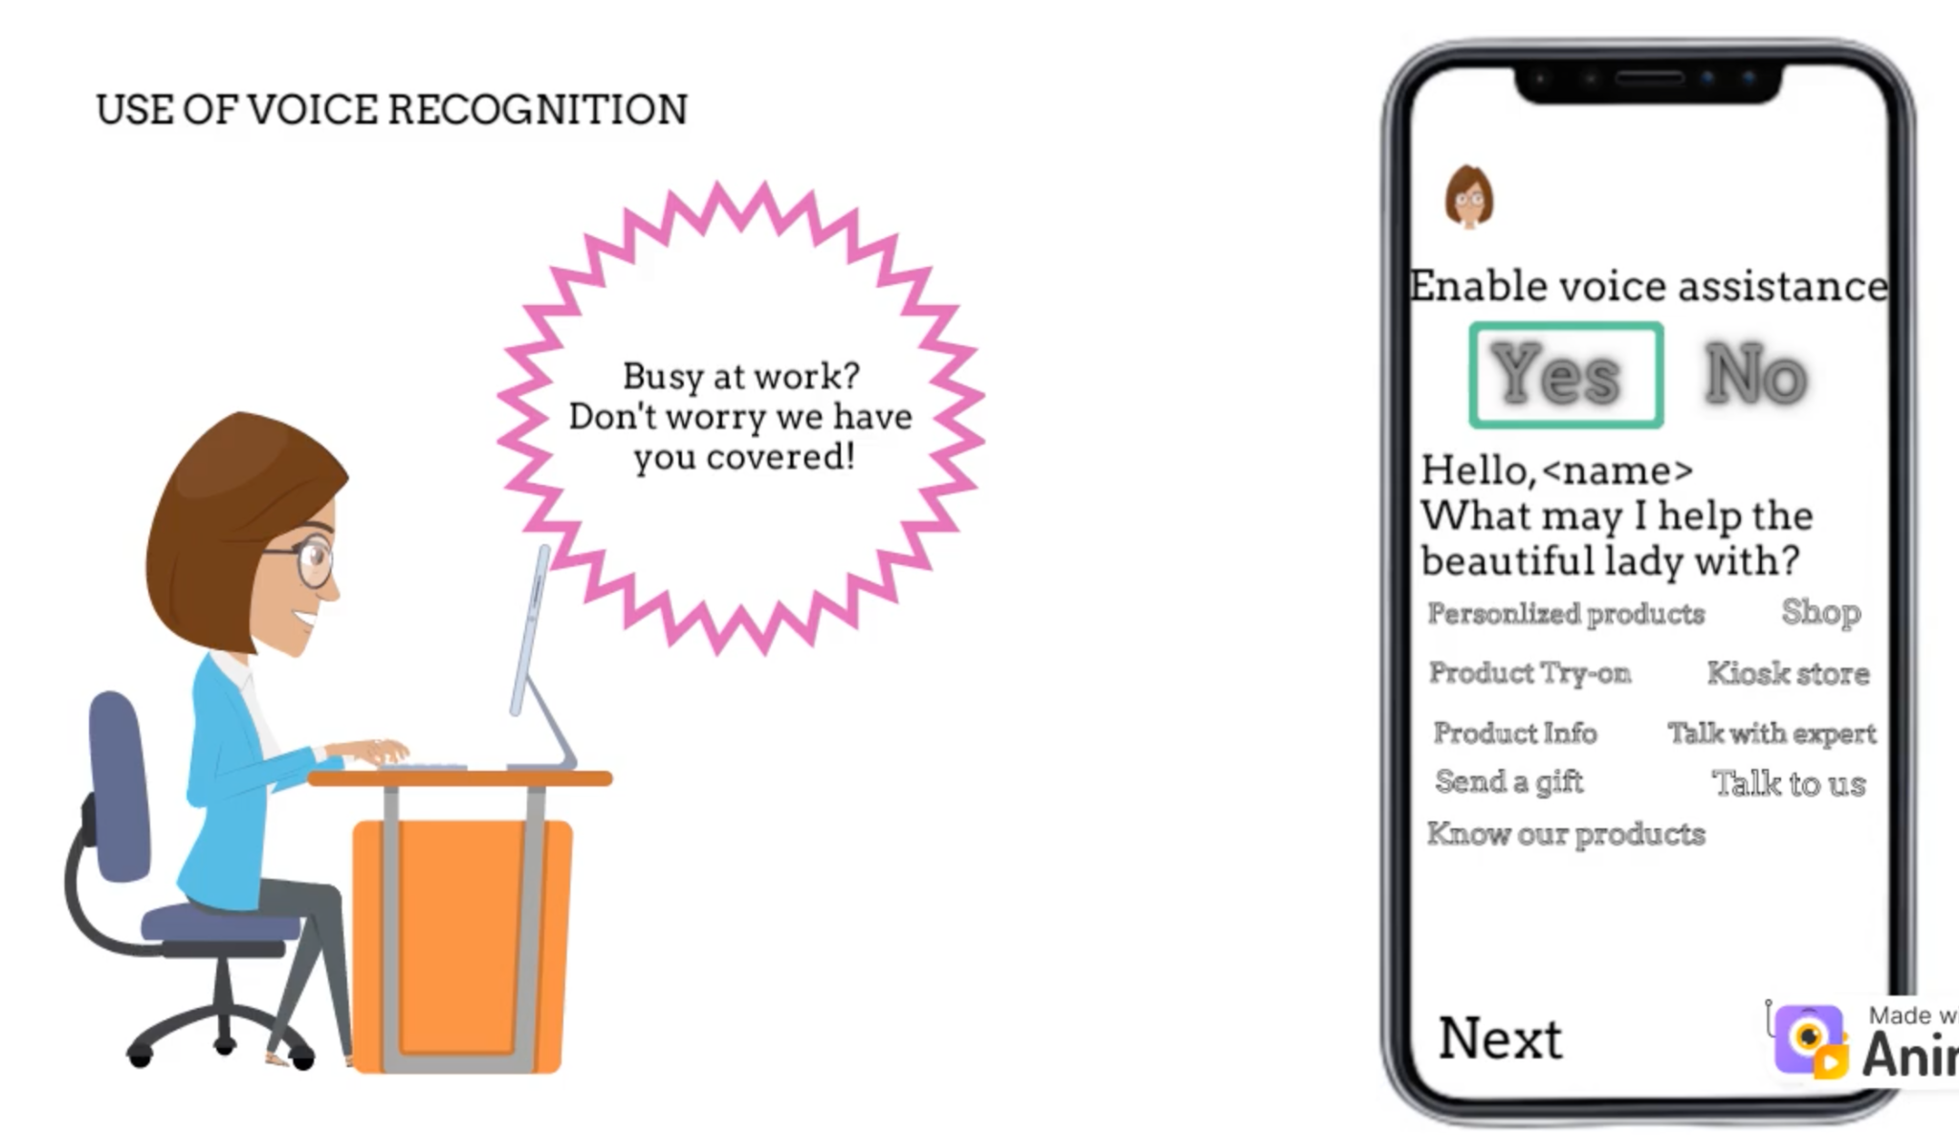
Voice-assistant to order and all other stuffs
An inbuilt voice assistant to help you perform actions in the application even if you’re busy or stuck somewhere.

Slide 13
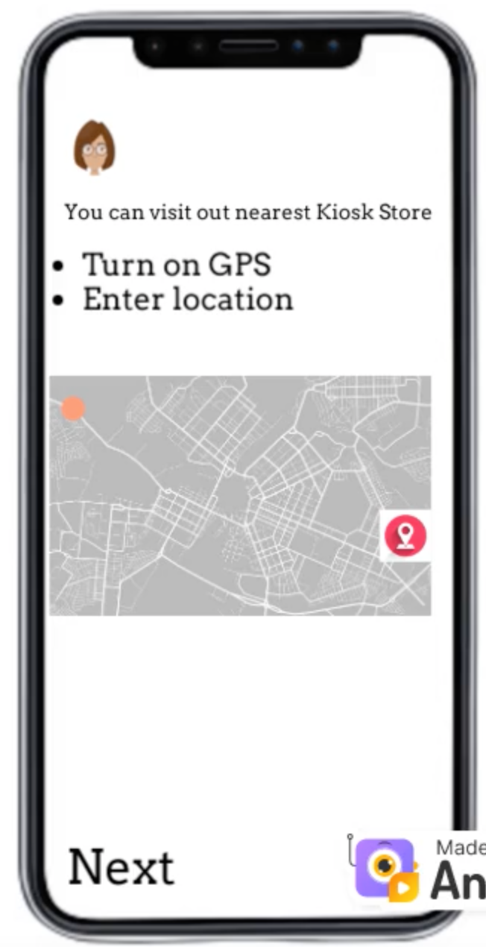
GPS Tracking
The enabled GPS will help you locate the nearest KIOSK store and also help in recommending products based on the region.
For eg.: If you live in the colder regions then the system will recommend you the suitable cold creams.

Slide 14
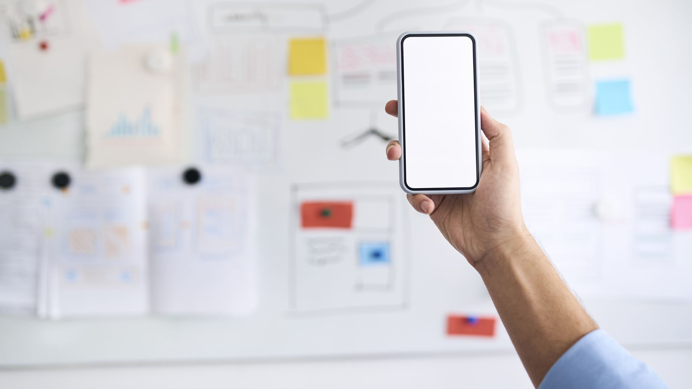
Novelty
AR with AI feature to try all directly on your face virtually.
Voice feature to directly order when you are busy or stuck at some place.
Redefining Loyalty program
KIOSK for try and buy
Personalized recommendation
Educating about prod and the benefits how different from another rival brand and then recommending.
WEB APP with a clean look and no hassle in buying experience. A clean UI.
Disclosing ingredients

Slide 15

Implementation

Slide 16
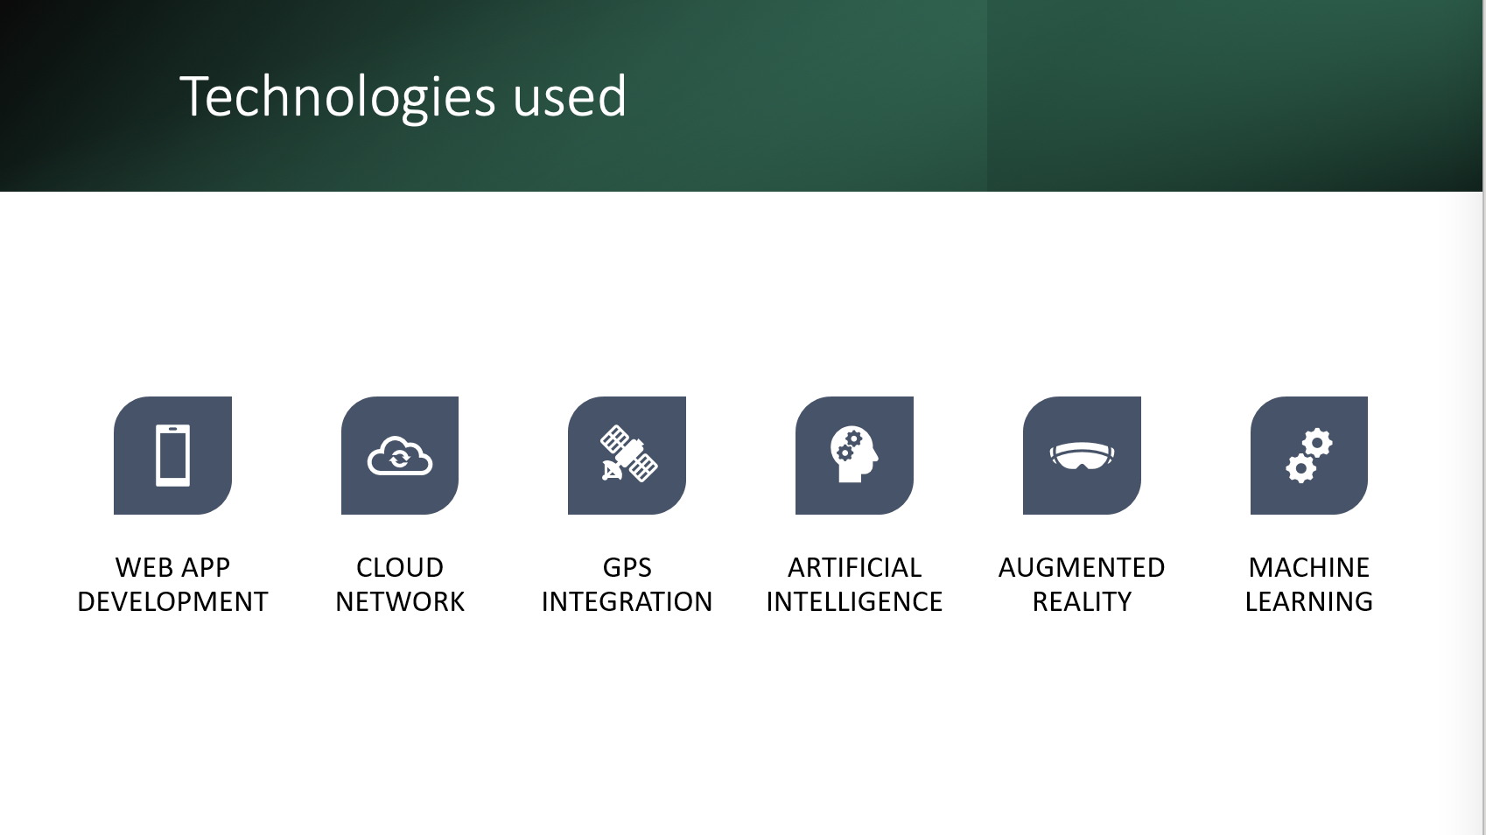

Slide 17
